Slide 1

Cloud Computing for Data Analysis Final Project
Music and Mental Health
Group Members:
Anudeep Billa
Aasish Chunduri
Govind Rahul Mathamsetti
Neethika Reddy Arepally
Lavanya Krishnan
December 9th 2023
Notes:
Students: Use this template to effectively present and communicate your group project to a broader audience. Your students can also use this presentation as a portfolio of their work to demonstrate their cloud skills.
The presentation structure is listed below. The total time may vary depending on the activities your team wants to include. For example, your team may to provide a high-level walkthrough of your work solutions versus a deep-dive into why or how your team chose certain services and the steps of building the architectures.
Suggested timing for a 10-minute presentation:
Introduction – 1 minute
Business scenario overview – 1 minute
Solution overview – 2 minutes
Architecture diagram of the solution – 2 minutes
Demo – 3 minutes
Lessons learned – 1 minute

Slide 2
Introduction
In this project we are investigating correlations between music preferences and self-reported mental health statuses.
Analyzing diverse music genres to understand their links to anxiety, depression, insomnia, and OCD.
Exploring potential connections between individual musical choices and mental well-being.
Establishing correlations to personalize interventions for mental health conditions.
Unveiling how different music genres may impact and relate to various mental health states.
Notes:
Define the problem or opportunity that you are addressing. Include pictures, figures, and statistics to help the audience better conceptualize the problem or opportunity.
Specify who your users or customers are and why they care..
List any specific business requirements that you are addressing.
Note:
A good overview succinctly defines the problem and opportunity statement. For example: “Customers with media files, such as retail companies, need an easy and cost-effective way to analyze photos and videos of their inventory.”
A below standard overview is too verbose, technical, or not specific. For example: “The most common media files are .jpg and .mp4. Companies have media files of their inventory.”

Slide 3
Business scenario overview
Problem: Current limitations exist in correlating individual music preferences with specific mental health conditions like anxiety, depression, insomnia, and OCD. Standardized approaches for personalized music therapy are lacking, hindering its efficacy in mental health care.
Opportunity: Utilize data-driven insights to establish correlations between music genres and mental health states, aiming to personalize music therapy interventions for enhanced mental well-being
Notes:
Define the problem or opportunity that you are addressing. Include pictures, figures, and statistics to help the audience better conceptualize the problem or opportunity.
Specify who your users or customers are and why they care..
List any specific business requirements that you are addressing.
Note:
A good overview succinctly defines the problem and opportunity statement. For example: “Customers with media files, such as retail companies, need an easy and cost-effective way to analyze photos and videos of their inventory.”
A below standard overview is too verbose, technical, or not specific. For example: “The most common media files are .jpg and .mp4. Companies have media files of their inventory.”

Slide 4
Business scenario overview
Solution Requirements:
Data Integration: Gather and merge comprehensive datasets encompassing music preferences and self-reported mental health conditions across various genres.
Analytical Tools: Employ machine learning algorithms to analyze and identify patterns or correlations within the collected datasets.
Predictive Models: Develop models that predict potential music therapy interventions based on identified correlations.
Ethical Considerations: Ensure data privacy, security, and mitigate biases in dataset collection and analysis.
Collaborative Framework: Facilitate interdisciplinary collaboration among music therapists, clinicians, and data scientists to translate findings into effective therapy strategies.
Notes:
Define the problem or opportunity that you are addressing. Include pictures, figures, and statistics to help the audience better conceptualize the problem or opportunity.
Specify who your users or customers are and why they care..
List any specific business requirements that you are addressing.
Note:
A good overview succinctly defines the problem and opportunity statement. For example: “Customers with media files, such as retail companies, need an easy and cost-effective way to analyze photos and videos of their inventory.”
A below standard overview is too verbose, technical, or not specific. For example: “The most common media files are .jpg and .mp4. Companies have media files of their inventory.”

Slide 5
Solution overview
The solution involves leveraging data analytics and machine learning to establish correlations between individual music preferences and mental health states.
By integrating diverse datasets encompassing music listening habits and self-reported mental health conditions across various genres, the system aims to generate insights that personalize music therapy interventions.
Notes:
Explain at a high level what you have built.
For example: “Our team built a web application for a company to host their blog.“
Talk about why you chose certain parts of the solutions and any tradeoffs that you made. Focus on how you designed the solutions and how you applied the AWS Well-Architected Framework as part of the process (AWS Well-Architected Framework: https://docs.aws.amazon.com/wellarchitected/latest/framework/welcome.html).
For example: “Our team configured load balancers and auto scaling to make the application highly available and reliable.”
Include the use cases that you are addressing. Think about who your users are and how they would want to interact with your solution to solve their problem.
For example: “Users can view, upload, edit, and delete blog posts. Administrators can approve blog posts.”
Talk about the use cases that you addressed as part of the minimum viable product (MVP) that you scoped and built.
Note:
An above-bar description is concise and includes the most important benefits. For example: “The solution allows customers to quickly upload, store, and search large catalogs of images and videos in Amazon S3.”
A below-bar description is too detailed or not specific. For example: “Our solution analyzes media files.”

Slide 6
Solution overview
Design Considerations:
Data Integration and Quality: Consolidate diverse datasets while ensuring accuracy, completeness, and relevance of music and mental health data.
Machine Learning Algorithms: Implement robust algorithms to analyze correlations and patterns within the integrated datasets.
Ethical and Privacy Measures: Adhere to data privacy regulations, anonymize sensitive information, and address biases in dataset collection and analysis.
Interdisciplinary Collaboration: Foster collaboration between music therapists, clinicians, and data scientists to interpret findings and design personalized interventions.
Scalability and Flexibility: Design a scalable framework capable of handling increasing data volumes and adaptable to evolving mental health insights
Notes:
Explain at a high level what you have built.
For example: “Our team built a web application for a company to host their blog.“
Talk about why you chose certain parts of the solutions and any tradeoffs that you made. Focus on how you designed the solutions and how you applied the AWS Well-Architected Framework as part of the process (AWS Well-Architected Framework: https://docs.aws.amazon.com/wellarchitected/latest/framework/welcome.html).
For example: “Our team configured load balancers and auto scaling to make the application highly available and reliable.”
Include the use cases that you are addressing. Think about who your users are and how they would want to interact with your solution to solve their problem.
For example: “Users can view, upload, edit, and delete blog posts. Administrators can approve blog posts.”
Talk about the use cases that you addressed as part of the minimum viable product (MVP) that you scoped and built.
Note:
An above-bar description is concise and includes the most important benefits. For example: “The solution allows customers to quickly upload, store, and search large catalogs of images and videos in Amazon S3.”
A below-bar description is too detailed or not specific. For example: “Our solution analyzes media files.”

Slide 7
Solution overview
Personalized Therapy Recommendations: Generate tailored music therapy recommendations based on an individual's music preferences and reported mental health conditions.
Predictive Models for Intervention: Develop predictive models suggesting specific music interventions for various mental health profiles.
Research Insights: Provide researchers with valuable insights into the correlation between music genres and mental well-being for further studies.
Clinical Decision Support: Assist mental health clinicians in recommending music-based interventions aligned with patient profiles.
Notes:
Explain at a high level what you have built.
For example: “Our team built a web application for a company to host their blog.“
Talk about why you chose certain parts of the solutions and any tradeoffs that you made. Focus on how you designed the solutions and how you applied the AWS Well-Architected Framework as part of the process (AWS Well-Architected Framework: https://docs.aws.amazon.com/wellarchitected/latest/framework/welcome.html).
For example: “Our team configured load balancers and auto scaling to make the application highly available and reliable.”
Include the use cases that you are addressing. Think about who your users are and how they would want to interact with your solution to solve their problem.
For example: “Users can view, upload, edit, and delete blog posts. Administrators can approve blog posts.”
Talk about the use cases that you addressed as part of the minimum viable product (MVP) that you scoped and built.
Note:
An above-bar description is concise and includes the most important benefits. For example: “The solution allows customers to quickly upload, store, and search large catalogs of images and videos in Amazon S3.”
A below-bar description is too detailed or not specific. For example: “Our solution analyzes media files.”

Slide 8
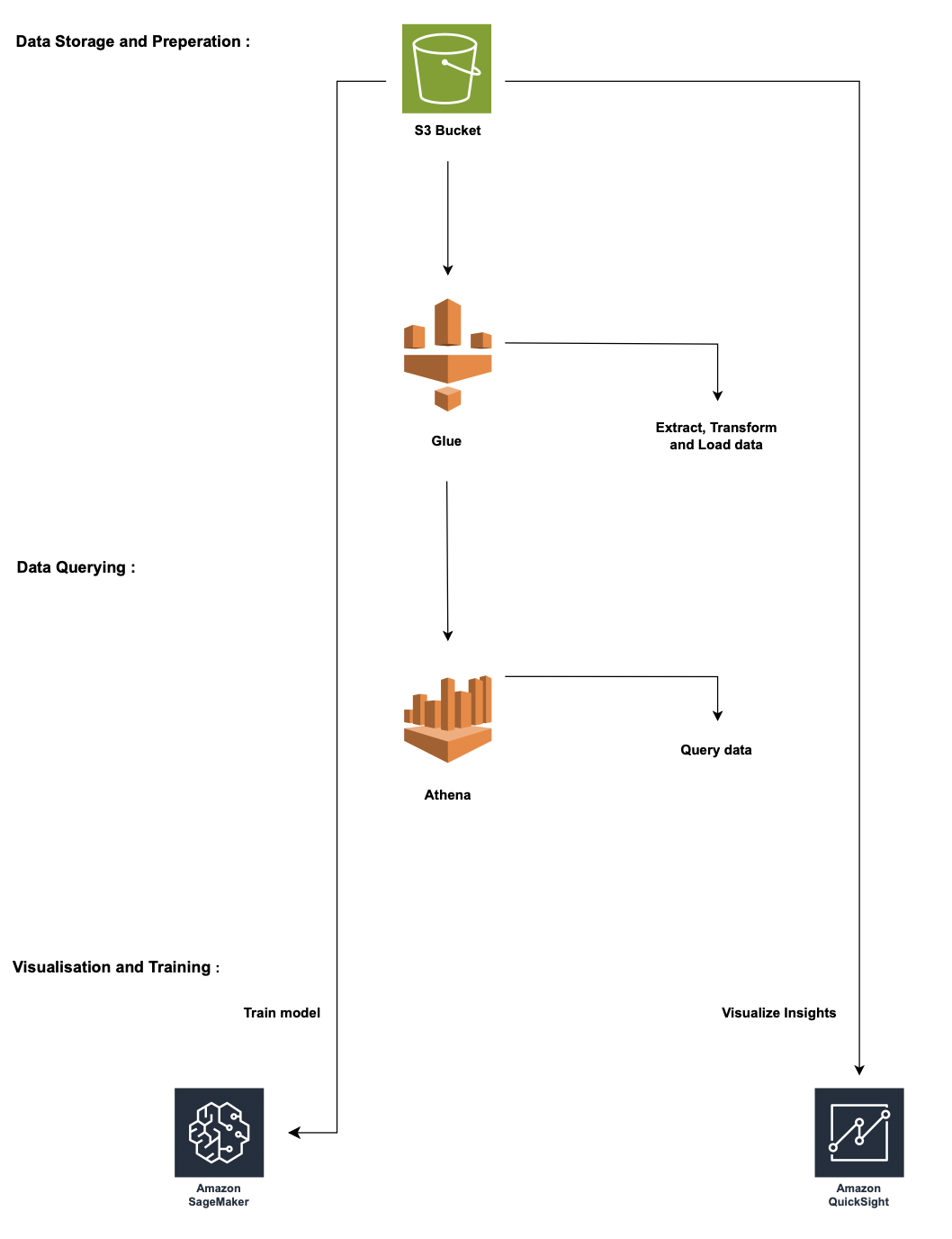
Architecture diagram of the solution
Notes:
Note: Remove this slide from your final presentation.
This example architecture diagram shows a solution to configure a webhook to link Git with AWS. You can find this example in the Toolkits for PowerPoint at https://aws.amazon.com/architecture/icons.

Slide 9
Machine Learning Lifecycle
Data Collection &
Integration
Exploratory Data
Analysis
Model
Development
Predictive
Modelling
Collaboration
& Documentation
Feedback loop
& optimization
Model Deployment
& Integration

Slide 10
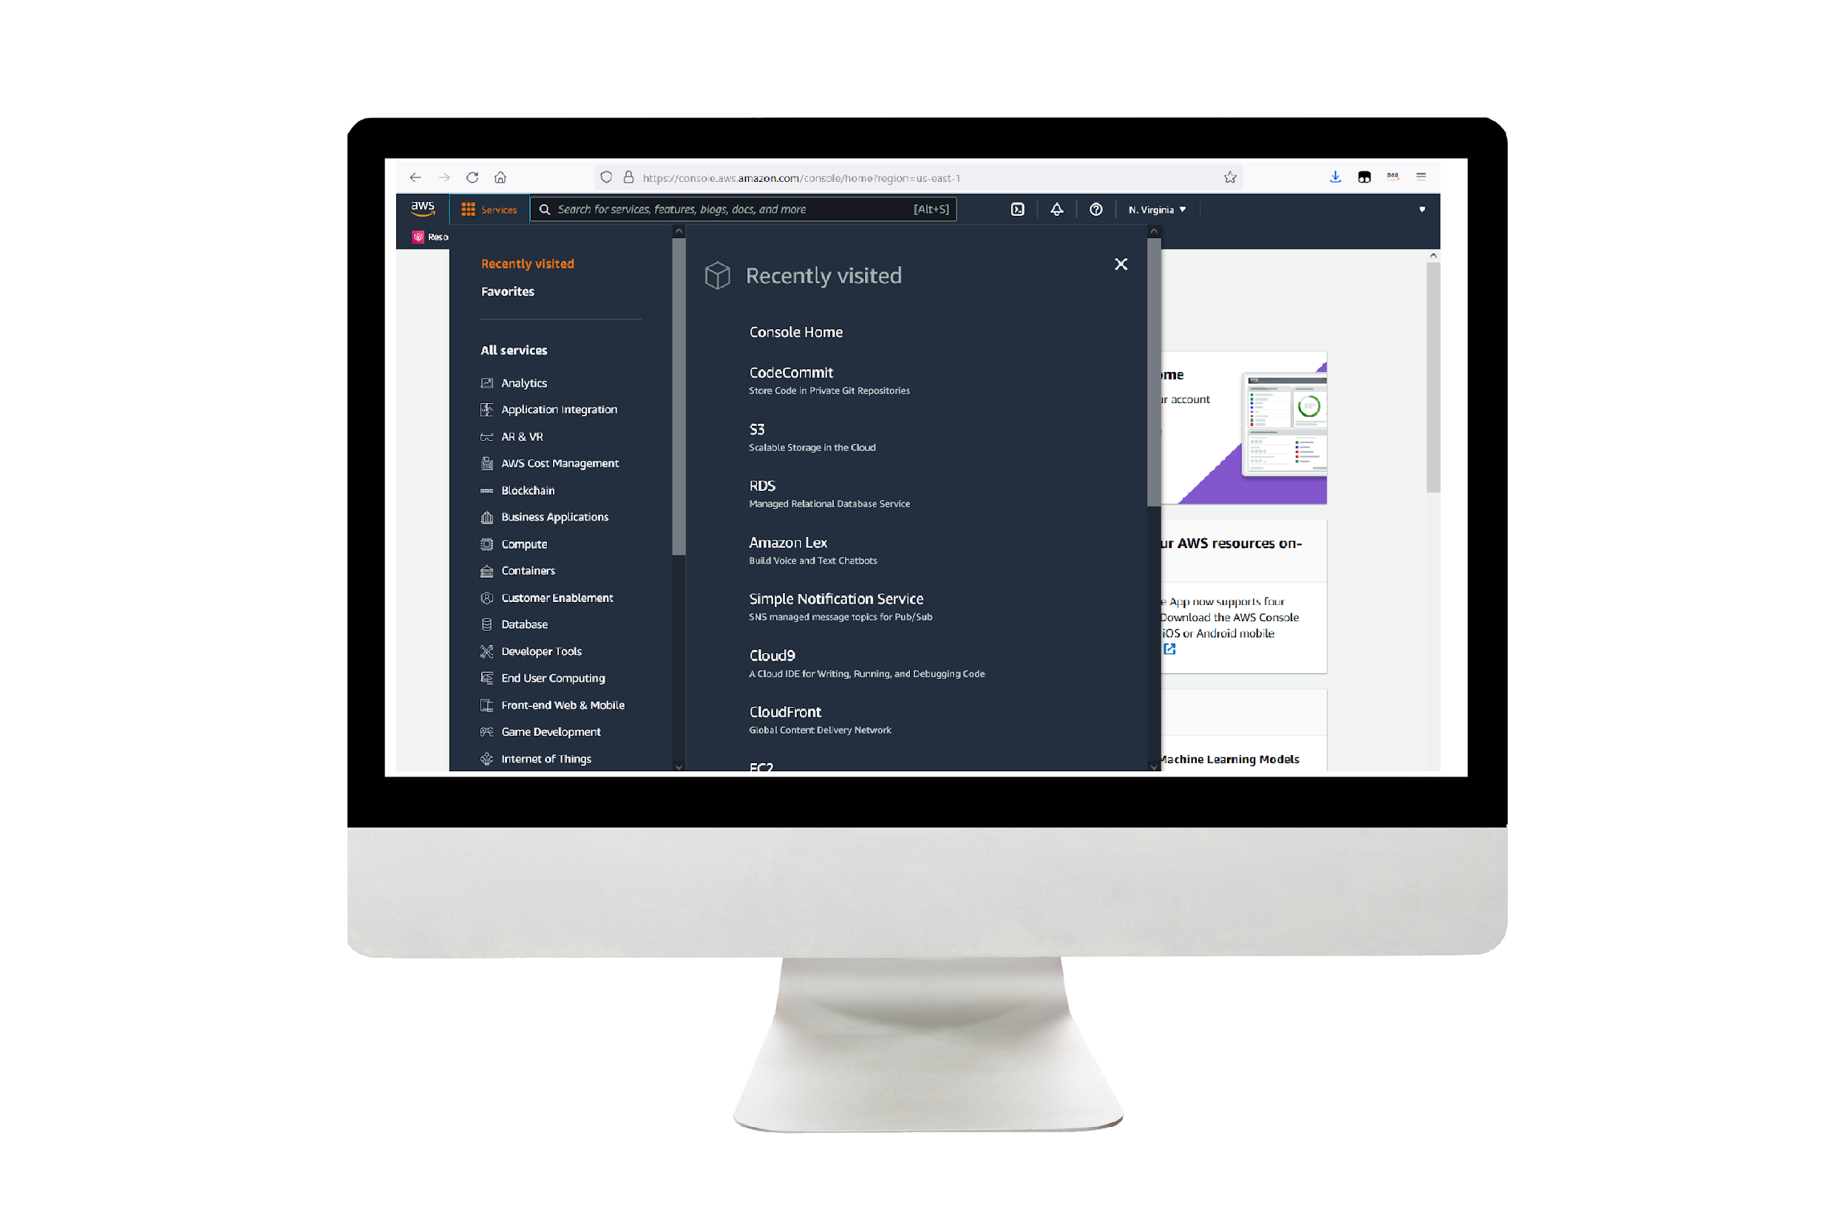
Demo
Demonstrate Your Project following the Machine Learning Lifecycle
Include any links to demonstration materials as appropriate, include screenshots
Notes:
For the demo, guide the audience through the two to three most important benefits of the solution and how it addresses the requirements.
Your demo materials can be screen captures, recordings, a link to your final solution, and/or a link to AWS console.

Slide 11
Lessons learned and Challenges:
Lessons Learned:
Data Quality Challenges: Recognizing the significance of high-quality, detailed metadata in music datasets for accurate analysis and correlations with mental health states.
Model Interpretability: Learning to communicate complex machine learning findings in a comprehensible manner to non-technical stakeholders like therapists and clinicians.
Continuous Improvement: Emphasizing the need for ongoing feedback loops to refine models and therapy recommendations based on real-world user experiences.
Challenges:
Limited Musical Data: Addressed the challenge of scarce quality musical data by leveraging multiple sources and refining data to ensure accuracy and relevance.
Subjectivity in User-Generated Data: Managed biases in music preferences by implementing robust statistical methods to identify correlations despite subjective inputs.
Notes:
Describe any challenges that you encountered and how you overcame those challenges.
For example: “I got stuck when I was creating an EC2 instance to host the application. I used the resources that were listed in the instructions to walk myself through the process to create a new EC2, and I was able to complete the task. The links to labs in other courses were very helpful.”
Describe any new skills that you learned from this project.
For example: “I learned how to set up auto scaling correctly so my resources were automatically adjusted and allocated at the lowest possible cost.”
Discuss any future, out-of-scope use cases in the next steps.
For example: “I would like to scale out the web application so that multiple departments can use it.”

Slide 12
Learning and Next Steps:
New Skills Utilized:
Advanced Data Preprocessing Techniques: Employed advanced data cleaning and feature engineering methods to handle complex music and mental health datasets.
Model Deployment and Integration: Gained proficiency in deploying machine learning models for practical use within therapy systems.
Effective Communication: Improved communication skills to articulate technical findings to non-technical stakeholders.
Next Steps:
Refinement of Predictive Models: Continuously refine and optimize models based on ongoing feedback and additional data.
Expand Dataset and Analysis: Include more diverse datasets and conduct deeper analysis to uncover nuanced correlations.
Long-term Assessment: Assess the long-term impact of personalized therapy recommendations on patients' mental health and well-being.
Explore New Technologies: Investigate emerging technologies that can enhance the platform's capabilities, such as natural language processing for sentiment analysis of music lyrics.
Notes:
Describe any challenges that you encountered and how you overcame those challenges.
For example: “I got stuck when I was creating an EC2 instance to host the application. I used the resources that were listed in the instructions to walk myself through the process to create a new EC2, and I was able to complete the task. The links to labs in other courses were very helpful.”
Describe any new skills that you learned from this project.
For example: “I learned how to set up auto scaling correctly so my resources were automatically adjusted and allocated at the lowest possible cost.”
Discuss any future, out-of-scope use cases in the next steps.
For example: “I would like to scale out the web application so that multiple departments can use it.”

Slide 13
Resources:
https://www.kaggle.com/datasets/catherinerasgaitis/mxmh-survey-results
https://diposit.ub.edu/dspace/bitstream/2445/189148/1/TFM-ECO_Roman_2022.pdf
https://archives.ismir.net/ismir2021/paper/000044.pdf
https://www.researchgate.net/publication/360396590_Psychological_effects_of_music_on_mental_health
https://www.frontiersin.org/articles/10.3389/fpsyg.2022.998451/full
https://link.springer.com/article/10.1007/s10597-021-00843-4
Notes:
Describe any challenges that you encountered and how you overcame those challenges.
For example: “I got stuck when I was creating an EC2 instance to host the application. I used the resources that were listed in the instructions to walk myself through the process to create a new EC2, and I was able to complete the task. The links to labs in other courses were very helpful.”
Describe any new skills that you learned from this project.
For example: “I learned how to set up auto scaling correctly so my resources were automatically adjusted and allocated at the lowest possible cost.”
Discuss any future, out-of-scope use cases in the next steps.
For example: “I would like to scale out the web application so that multiple departments can use it.”

Slide 14
Thank you

